Slide 1
gRNA/Cas9
Molecular Dynamics
Zhewei Chen
Ch121 Final Project
04/24/2019

Slide 2
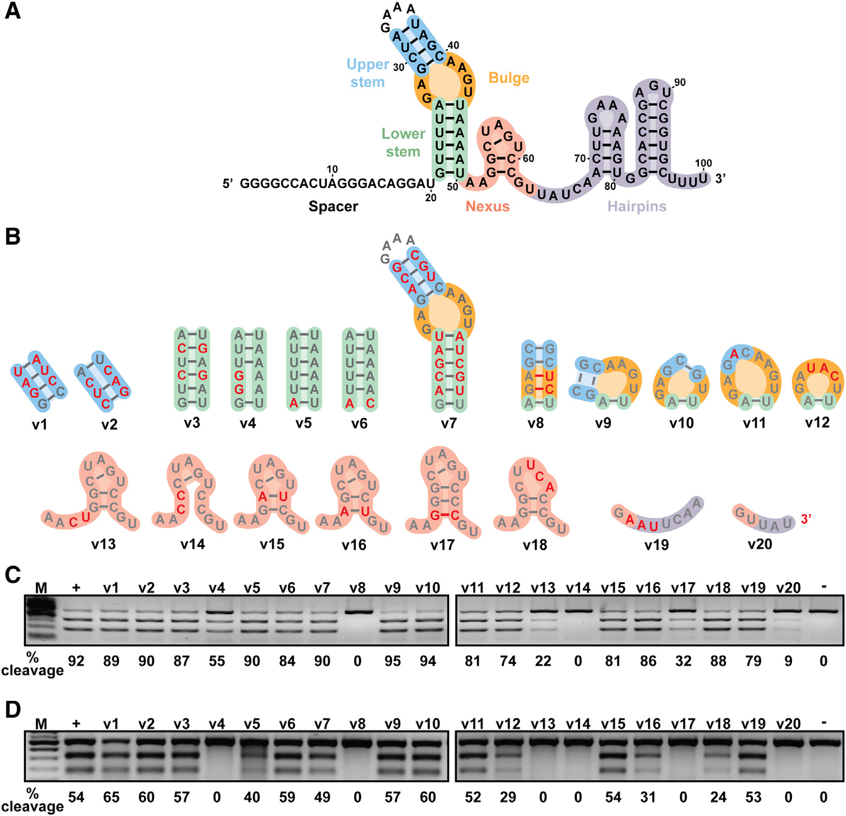
gRNAs have structure and function
Mutations boxed in red cause complete loss of gRNA activity
Mutations boxed in yellow significantly decreases gRNA activity
Nexus region and bulge loops are most important gRNA binding motifs
Cas9 handle stem needed for dCas9 binding
Terminator hairpins needed for termination and maybe function?
From Briner et al 2014, “Guide RNA Functional Modules Direct Cas9 Activity and Orthogonality”

Slide 3
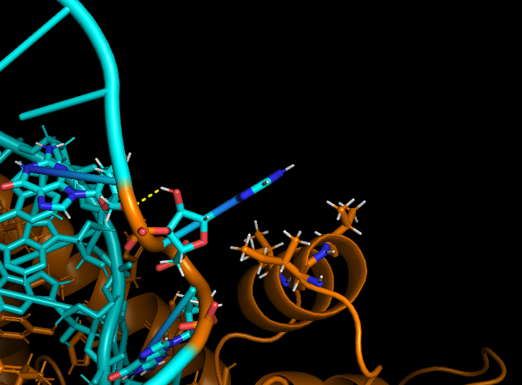
But are there salt bridges?
In dCas9 handle?
Left bulge is important for function, but does not have any apparent salt bridges with dCas9.
No interactions with the protein at all. The nearby side chains are all non-polar.
Yellow dashed lines =
all polar contacts between residues 4A away from the left bulge of gRNA

Slide 4
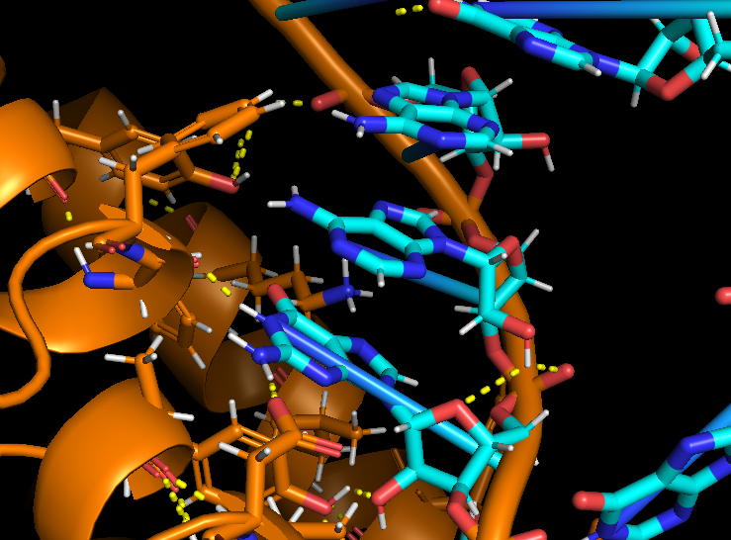
But are there salt bridges?
In dCas9 handle?
Right side bulge is important for function, but does not have any apparent salt bridges with dCas9.
Most salt bridges involve contact with the phosphate backbone of the gRNA
Yellow dashed lines =
all polar contacts between residues 4A away from the left bulge of gRNA

Slide 5
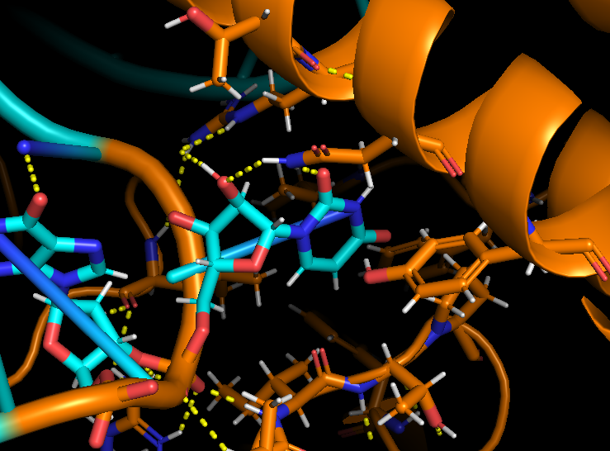
But are there salt bridges?
In Nexus domain?
Nexus loop is a very conserved domain. If there are a salt bridges, it should be here.
Here a single nucleotide fits inside some kind of binding pocket. However, this pocket is mostly non-polar.
Again, most salt bridges involve contact with the phosphate backbone of the gRNA.
Yellow dashed lines =
all polar contacts between residues 4A away from the left bulge of gRNA

Slide 6
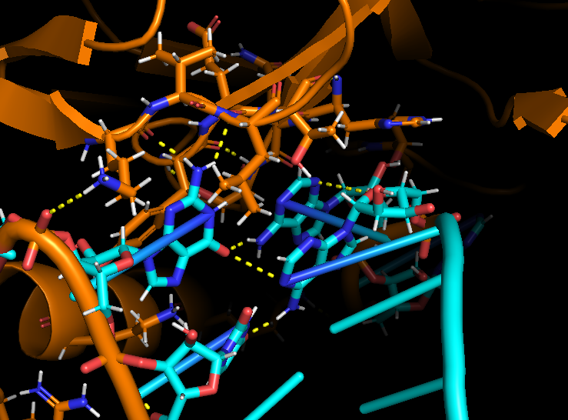
But are there salt bridges?
Near the Terminator stem?
The terminator loop is important for function. Breaking this loop enables the cgRNA activity switch.
Again, no significant hydrogen bonding with the protein. :??
Yellow dashed lines =
all polar contacts between residues 4A away from the left bulge of gRNA

Slide 7
Build some homology models
Approach
Introduce mutations to gRNA via RNA homology modeling
See how residues and domains move before and after mutations
If important interactions exist, we expect to see some diffusional shift during molecular dynamics simulation
Loses
activity
Retains
activity

Slide 8
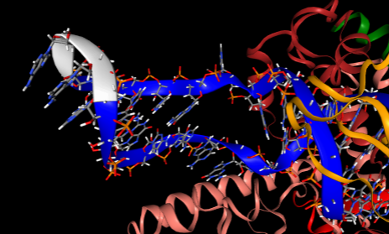
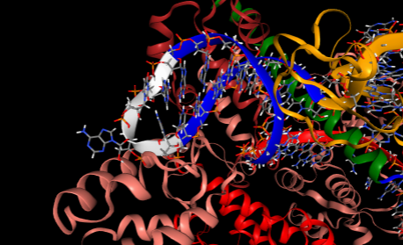
Build some homology models
Approach
Introduce mutations to gRNA via RNA homology modeling
See how residues and domains move before and after mutations
If important interactions exist, we expect to see some diffusional shift during molecular dynamics simulation
Unmodified gRNA
gRNA with deleted upper dCas9 handle

Slide 9
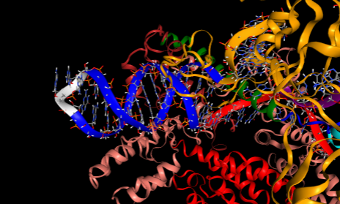
Build some homology models
Approach
Introduce mutations to gRNA via RNA homology modeling
See how residues and domains move before and after mutations
If important interactions exist, we expect to see some diffusional shift during molecular dynamics simulation
Unmodified gRNA
gRNA with deleted bulges

Slide 10
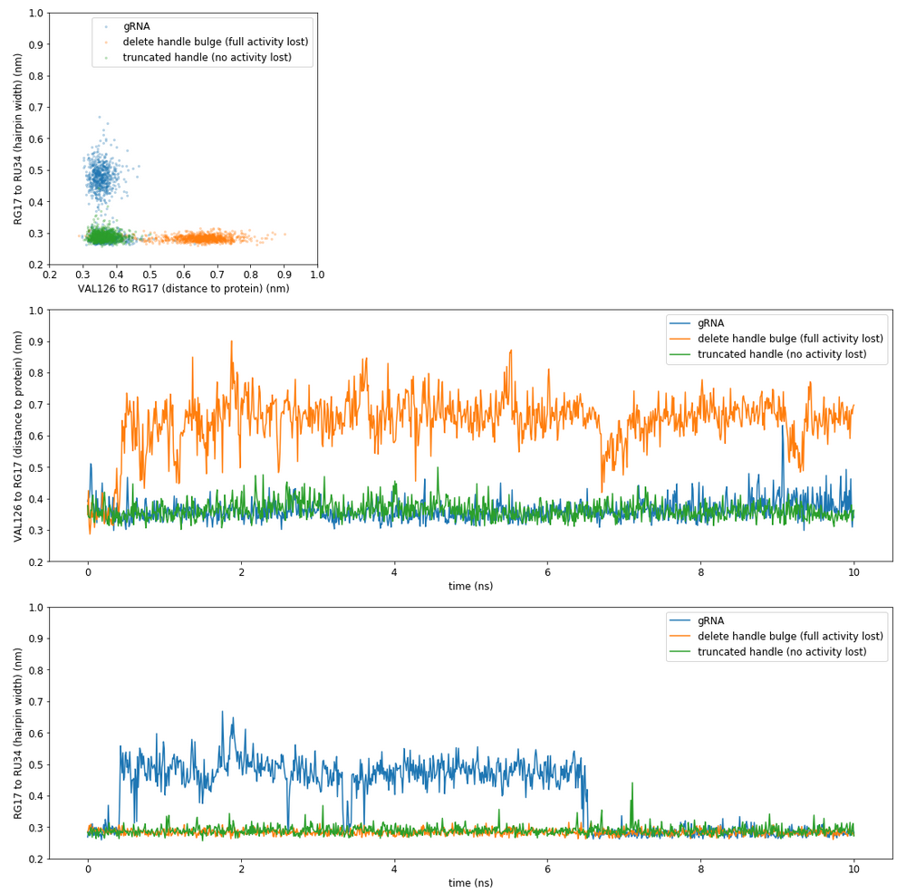
If we mutate, does it wiggle?
Deleting the bulge causes gRNA to wiggle more?
Truncated handle and regular gRNA do no wiggle much
Unclear if this would cause gRNA to fall out binding pocket in a longer trajectory simulation

Slide 11
Build some homology models
Approach
Introduce mutations to gRNA via RNA homology modeling
See how residues and domains move before and after mutations
If important interactions exist, we expect to see some diffusional shift during molecular dynamics simulation

Slide 12
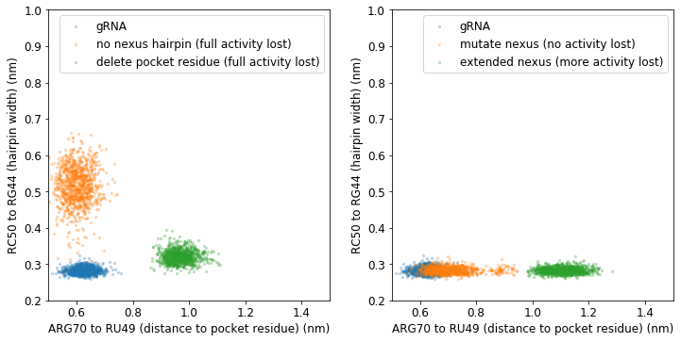
If we mutate, does it wiggle?
Hairpin starts to unfold, as expected
Still unclear how this affects protein activity?
Distance to pocket residue starts to increase as with mutations that disrupt function

Slide 13
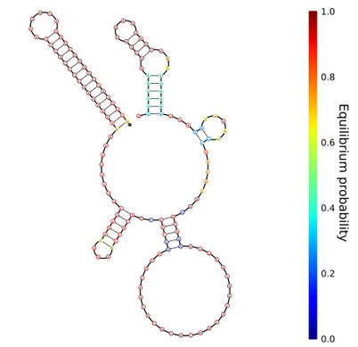
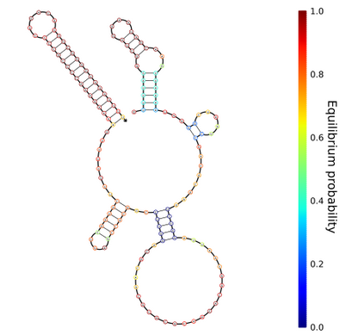
Build some homology models
Also made gRNAs and cgRNAs with weak or strong stems terminator stems
Approach
Introduce mutations to gRNA via RNA homology modeling
See how residues and domains move before and after mutations
If important interactions exist, we expect to see some diffusional shift during molecular dynamics simulation
cgRNA
(retains activity)
cgRNA no stem
(loses activity)

Slide 14
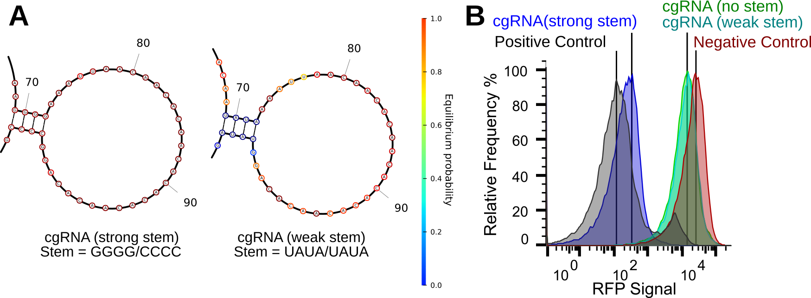
Novel structure function in
S. Pyogenes Terminator
More RFP signal means gRNA loses activity
From scRNA_Cas9_20190211ZC

Slide 15
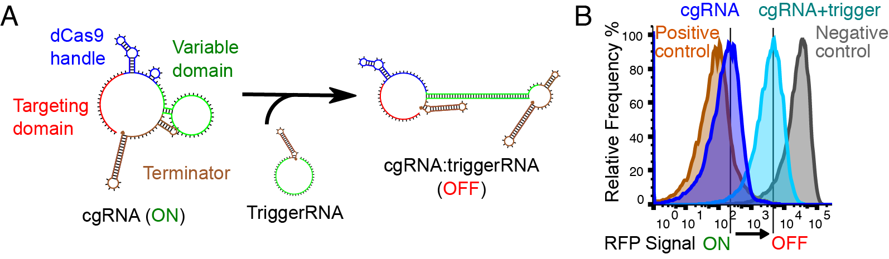
Novel activity switch mechanism
for CRISPR gRNAs
From one of my experiments long long ago

Slide 16
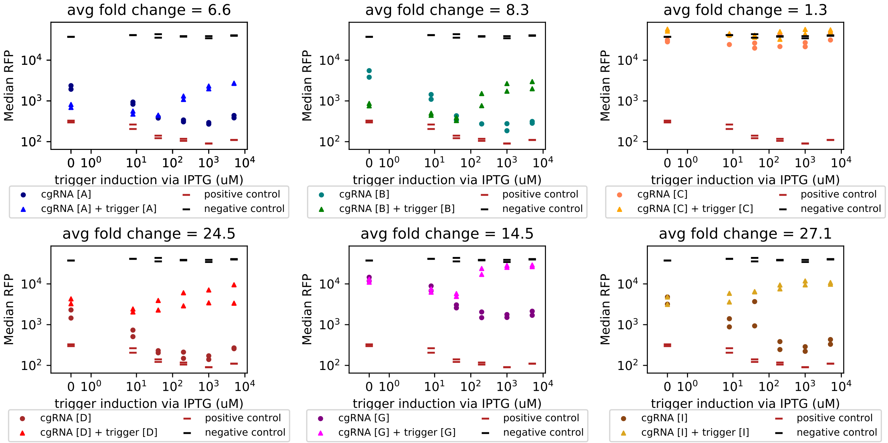
Orthogonal sets of
RNA regulators can be generated
cgRNAs are dose responsive and orthogonal to each other
From some experiment long long ago

Slide 17
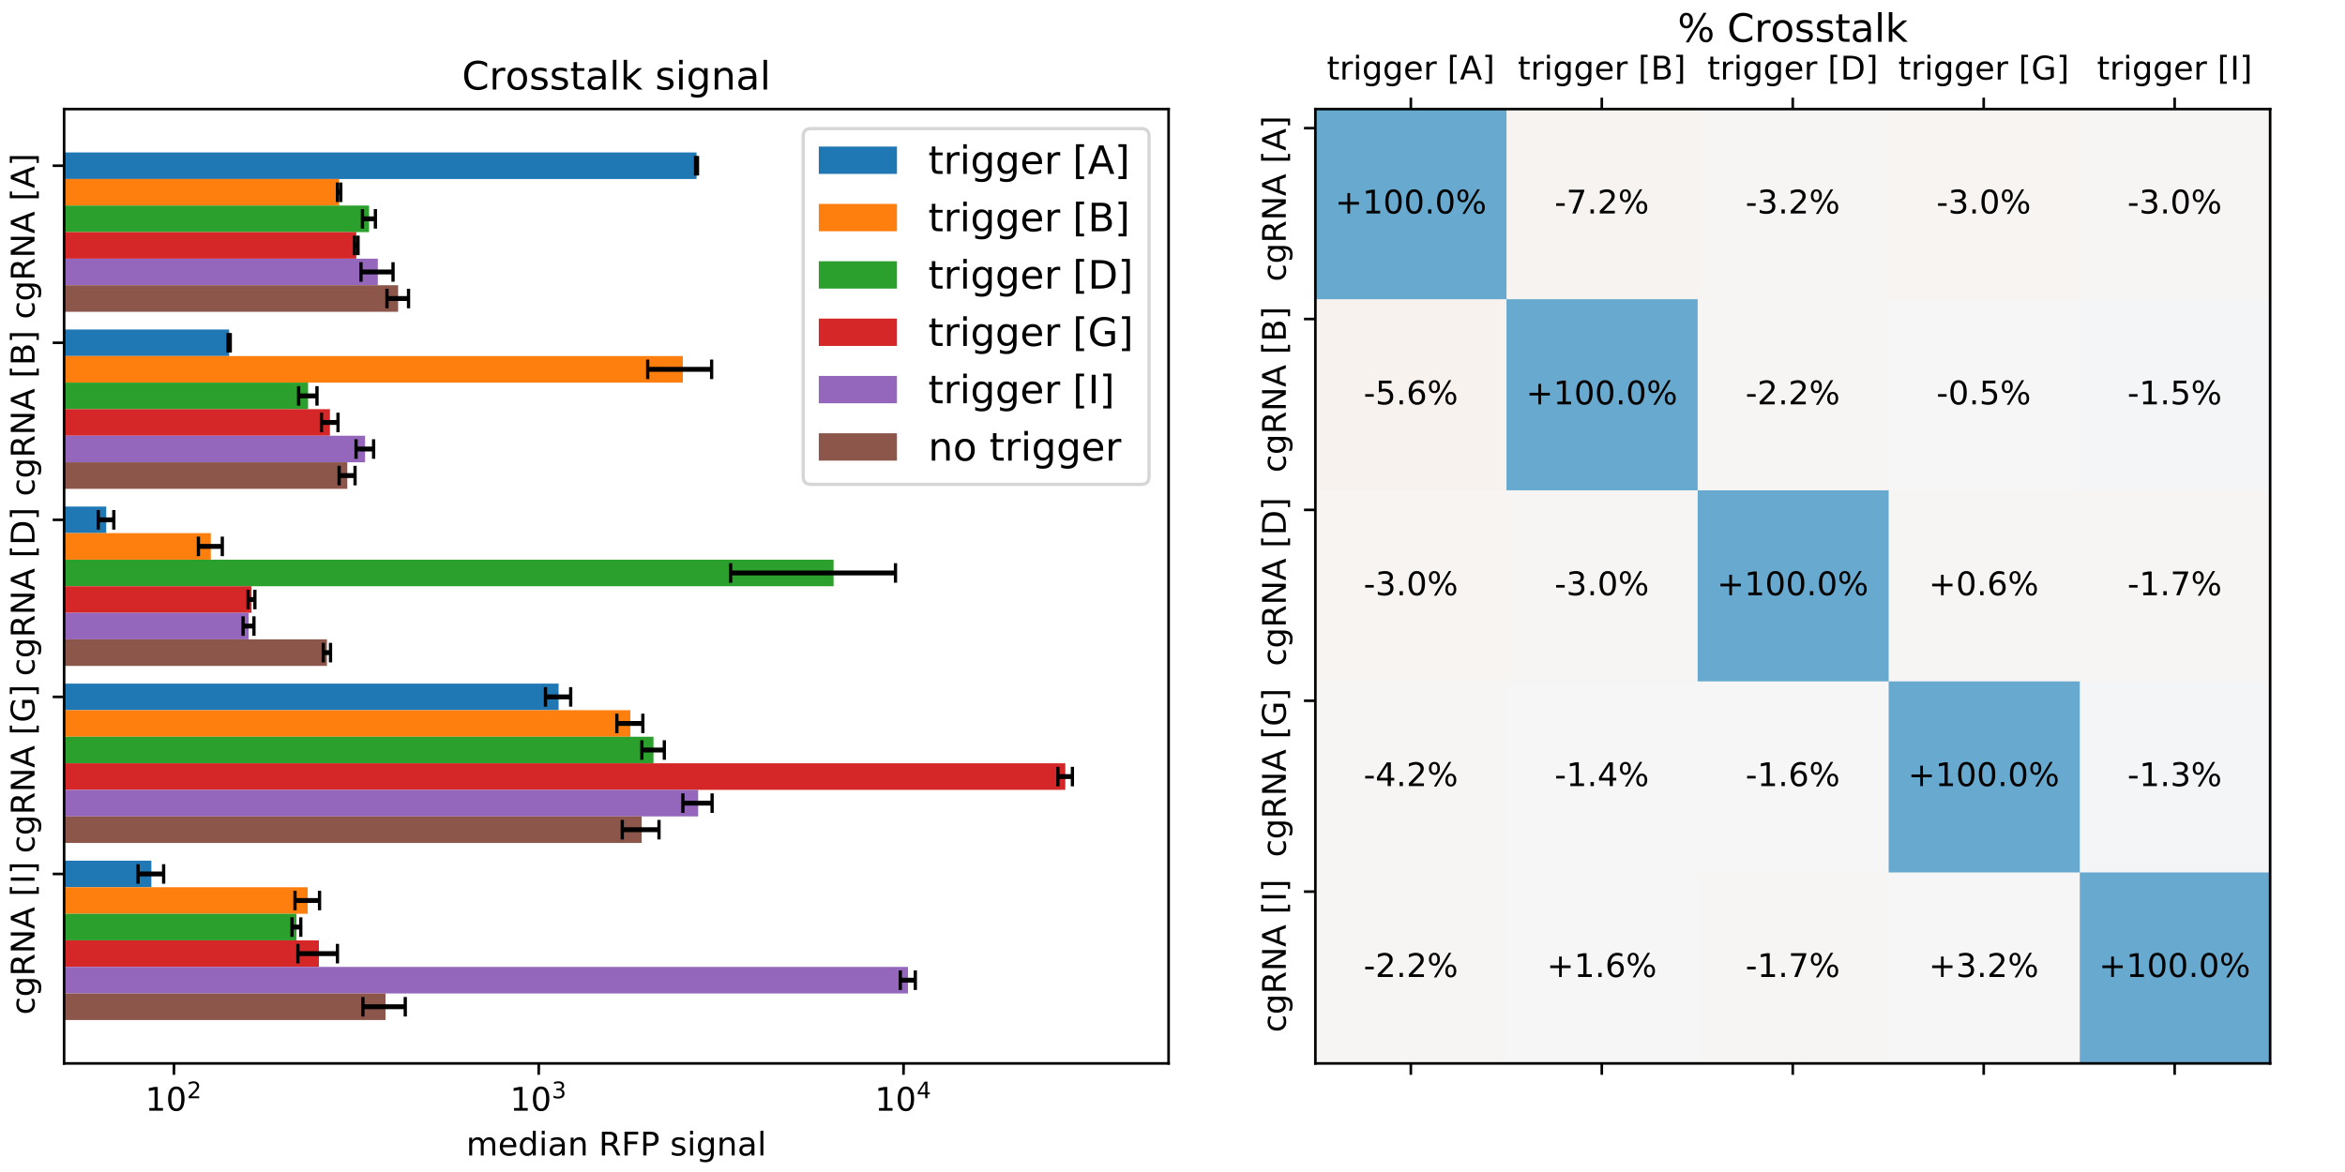
Orthogonal sets of
RNA regulators can be generated
cgRNAs are dose responsive and orthogonal to each other
From some experiment long long ago

Slide 18
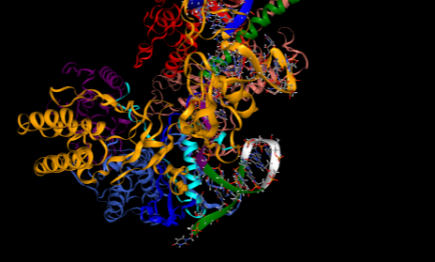
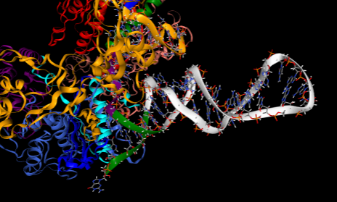
Can also make cgRNAs via Rosetta
Approach
Introduce mutations to gRNA via RNA homology modeling
See how residues and domains move before and after mutations
If important interactions exist, we expect to see some diffusional shift during molecular dynamics simulation
Unmodified gRNA
cgRNA

Slide 19
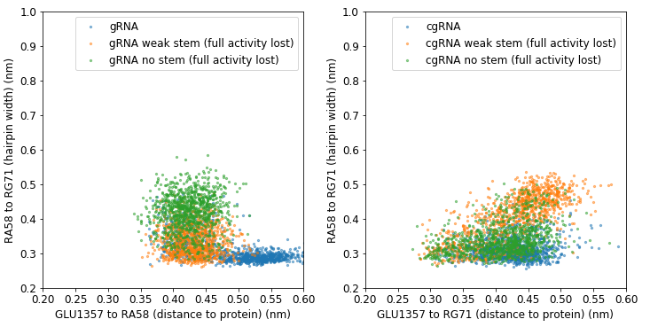
If we mutate, does it wiggle?
Hairpin width increases with hairpin breaking mutations (expected)
Distance to protein decreases for loss of function mutations :?
Molecular dynamics is not really informative on why cgRNA work

Slide 20
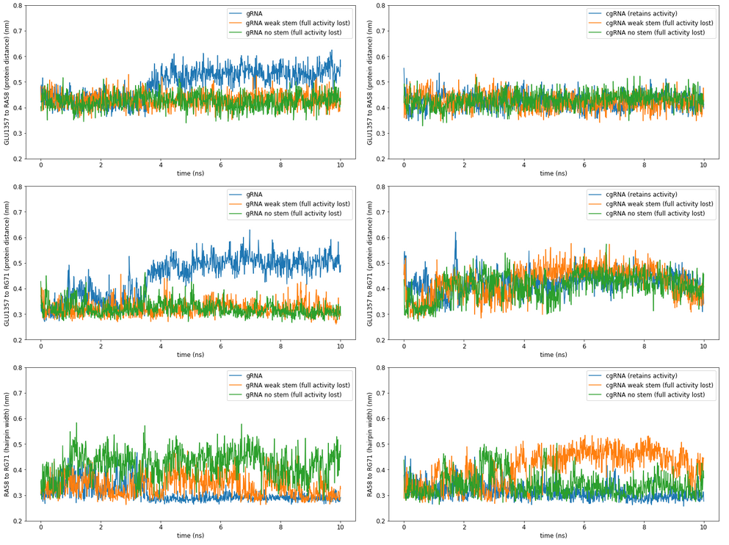
If we mutate, does it wiggle?
No interesting correlation with binding to protein surface
Hairpin width increases with hairpin breaking mutations (expected)

Slide 21
Challenges
Hard to simulate trajectories long enough to see something interesting
Most simulation effort wasted on water vibrations
Initial states are usually stuck in local energy minima

Slide 22
Possible next steps
Coarse graining with cgmartini and elastic network
Current system:
Total # of atoms = ~220k
Run time = 1 ns/hr
Coarse grained:
Total # of atoms = ~220k/50 = 4400 atoms?
Run time = 1ns/hr * 50 = 40ns/hr = ~1us per day
Adaptive weighted histogram sampling
Try to bias trajectories to sample under represented ensemble conformations
Can provide more efficient sample of reaction coordinate
http://courses.theophys.kth.se/SI3450/awh.pdf
Gaussian Accelerated molecular dynamics
Similar to AWH but only implement in Amber MD
Tries to use boost potentials to escape energies wells and do better sampling

Slide 23
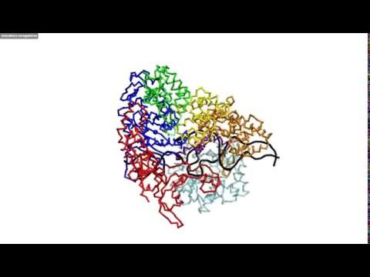
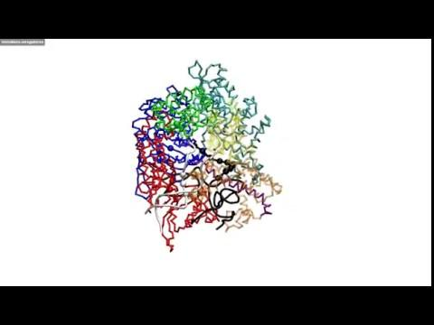
Coarse grain gRNA + Cas9 dynamics
Cas9 —> Cas9:gRNA
Cas9:gRNA —> Cas9:gRNA:DNA
Can be done with limited compute resources! :)
But results may not always be accurate
Results from https://doi.org/10.1002/prot.25229

Slide 24
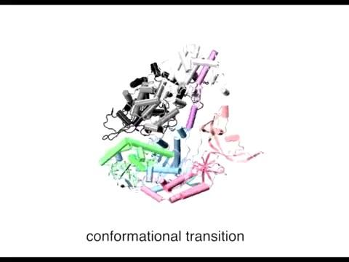
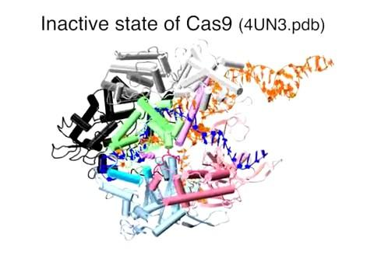
Or accelerated full atom MD?
Cas9 <— Cas9:gRNA
Cas9:gRNA:DNA —> Cas9 + DNA cleaved
Gaussian accelerated full atom trajectories run for 15us
—> too long to be practical biomolecule engineering
Results from https://doi.org/10.1073/pnas.1707645114

Slide 25
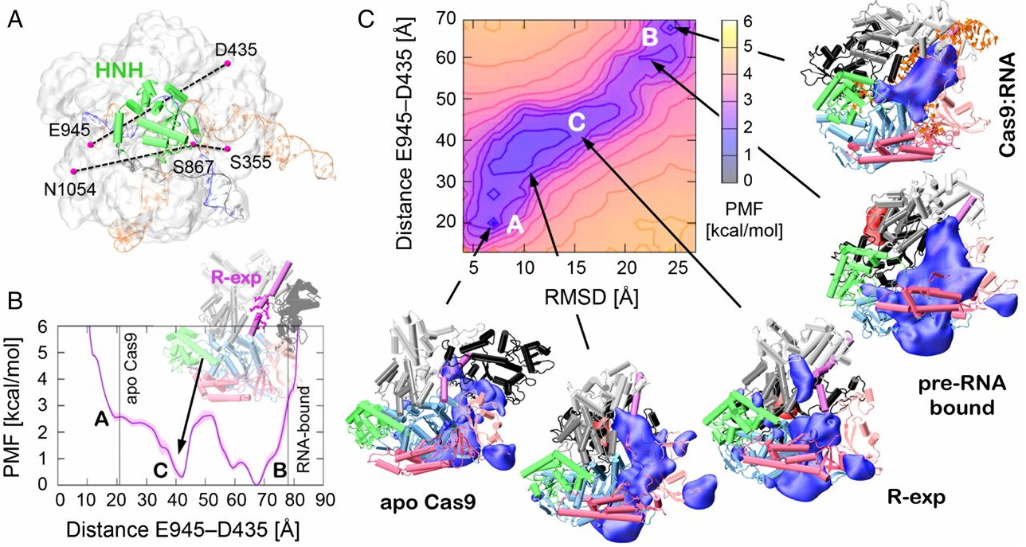
Mapping out the RNA docking energy landscape
If we could do gaMD, we can sample out the energy landscape for gRNA/Cas9 docking
—> use information to design better cgRNAs
Results from https://doi.org/10.1002/prot.25229

Slide 26
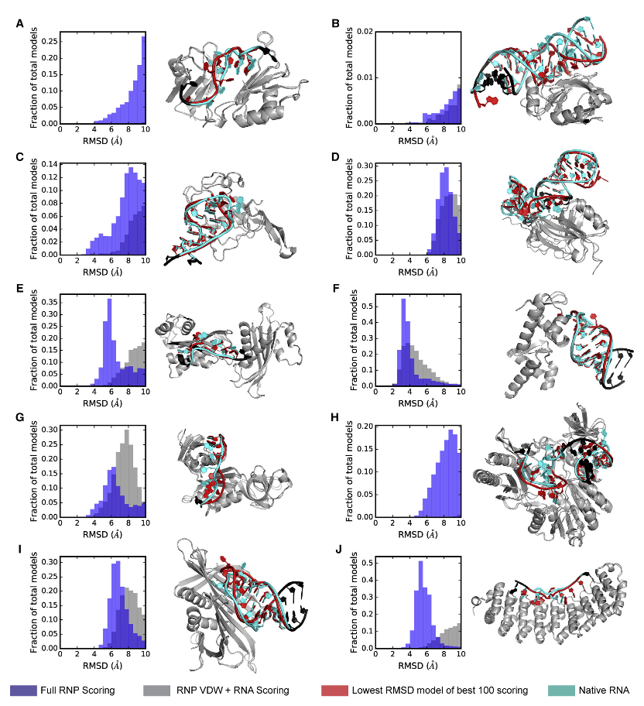
Actual Next Steps
Still need good starting states to do good reaction coordinate scans
Solution →
Use Rosetta RNA_denovo to sample for good RNA/protein docks of the Apo Cas9
But Problem →
RNA_denovo still requires good initial positions for building RNA/protein docks
Results from https://doi.org/10.1016/j.str.2018.10.001

Slide 27
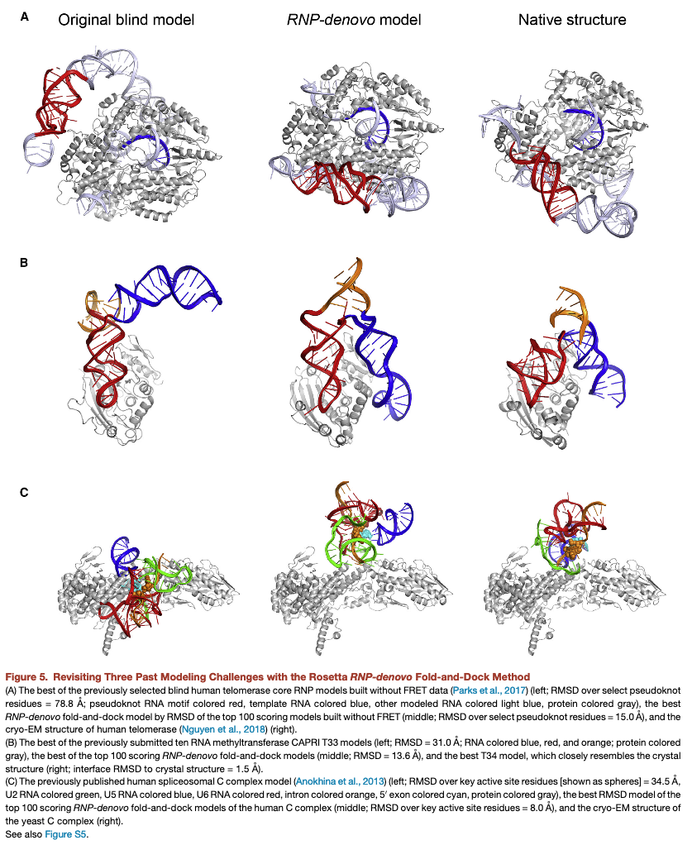
Actual Next Steps
Still need good starting states to do good reaction coordinate scans
Solution →
Use Rosetta RNA_denovo to sample for good RNA/protein docks of the Apo Cas9
But Problem →
RNA_denovo still requires good initial positions for building RNA/protein docks
Results from https://doi.org/10.1016/j.str.2018.10.001

Slide 28
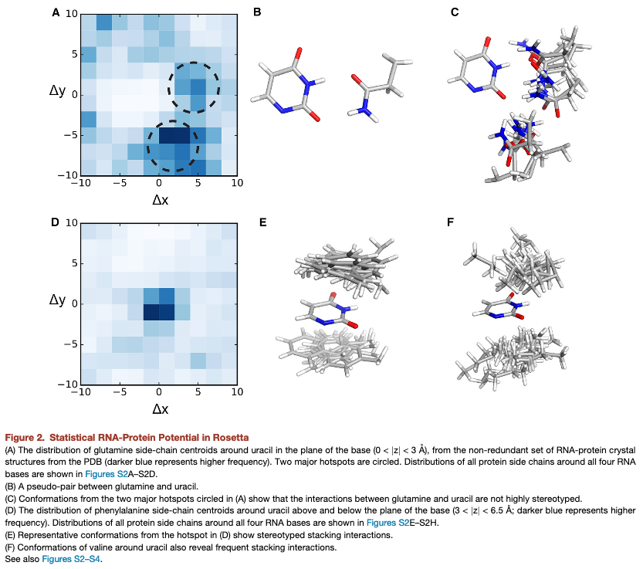
CNN recommender system for RNA/protein docking sites
Possible solution →
Train Convolution Neural Network (CNN) on PME electrostatics and learn about about good surface binding for protein/RNA
Why should it work? →
Statistical energy potential in RNA_denovo can pick up useful chemical features not represented in Rosetta force field model
Pseudo base pairing between gluamine and uracil
Pi-Pi stacking of aromatic residues
Results from https://doi.org/10.1016/j.str.2018.10.001

